Slide 1

Machine learning
Used-cars price prediction
Vasilis Vitzilaios mtn2201

Slide 2

Content table
Introduction
Data Overview
Exploratory Data Analysis
Model Results
Model Comparison
Conclusion
Data Preprocessing
Visual Analysis

Slide 3
Intro
Objectives of the project.
Importance of predicting car prices.
Models Used:
SGD Regression
Ridged Regression
Random Forest
k-NN

Slide 4
Data overview
Dataset Source: Kaggle
Number of classes: 65
Number of Samples: 20000
Number of features: 16

Slide 5
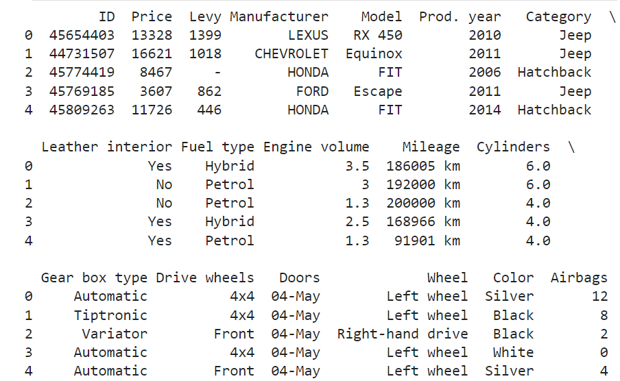
Data overview
head()

Slide 6
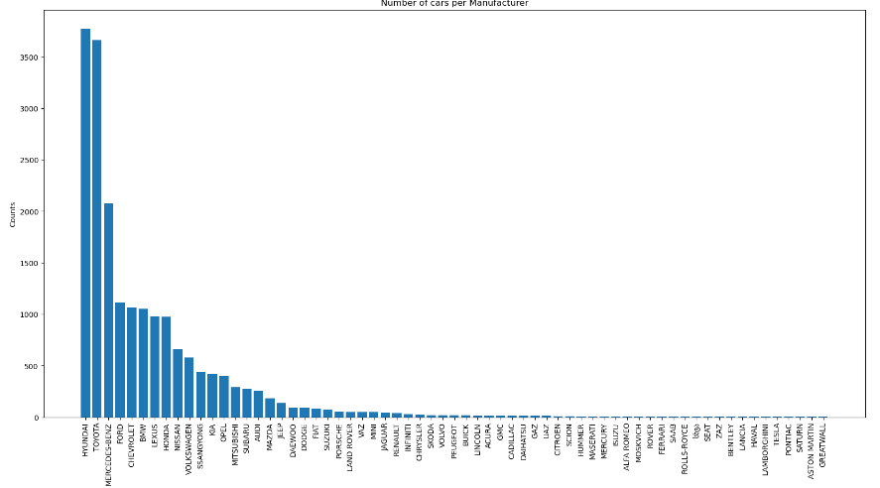
Data Analysis
Number of cars per Manufacturer

Slide 7
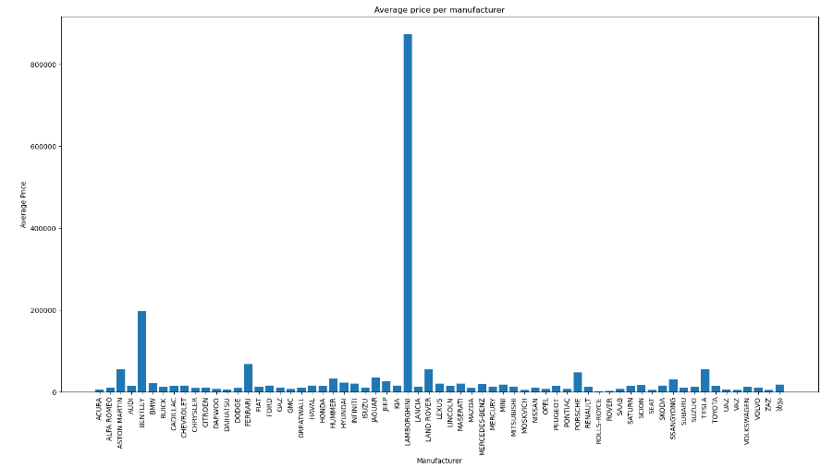
Data analysis
Average price per Manufacturer

Slide 8
Data Preprocessing
Handling missing values.
Feature scaling.
Transformation of categorical variables.
Remove outliers.

Slide 9
Model Results
SGD Regression
RMSE (Root Mean Square Error): 8761.945
MAE (Mean Absolute Error): 6588.529
R2 Score: 0.395
Time: 19.221s

Slide 10
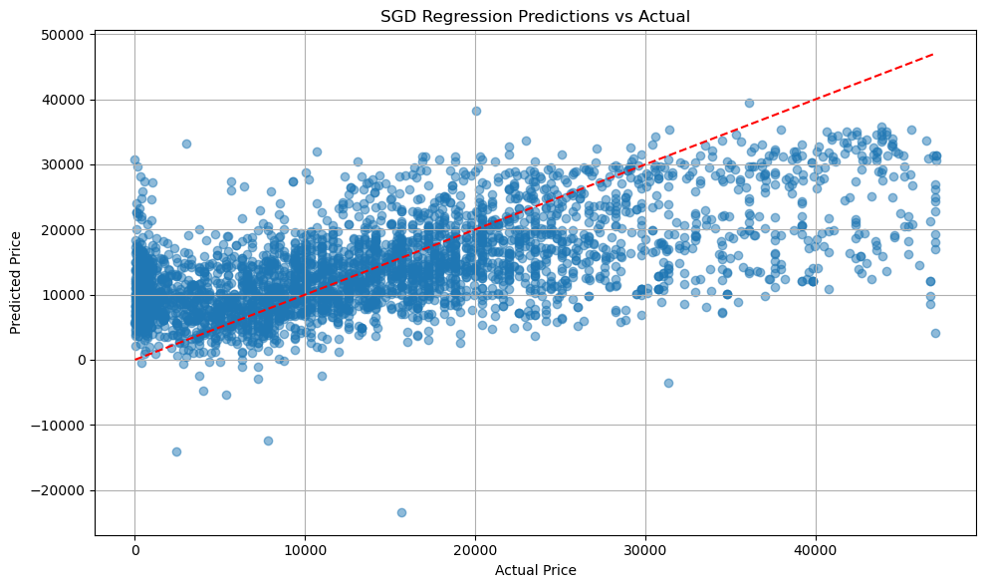
Model Results
SGD Regression

Slide 11
Model Results
Ridged Regression
RMSE (Root Mean Square Error): 8695.939
MAE (Mean Absolute Error): 6573.305
R2 Score: 0.404
Time: 2.156s

Slide 12
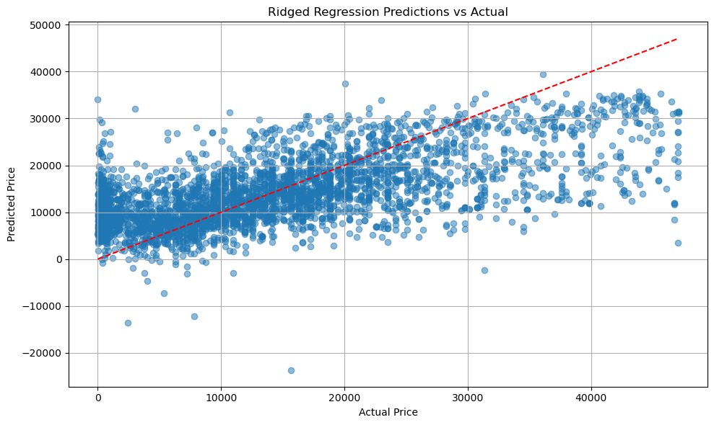
Model Results
Ridged Regression

Slide 13
Model Results
Random Forest
RMSE (Root Mean Square Error): 5652.026
MAE (Mean Absolute Error): 3464.535
R2 Score: 0.748
Time: 151.529s

Slide 14
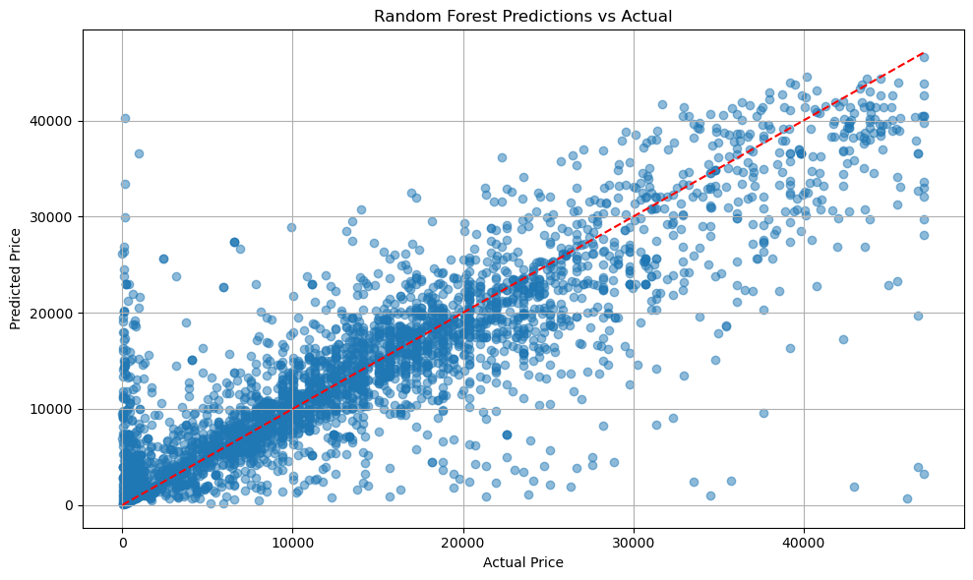
Model Results
Random Forest

Slide 15
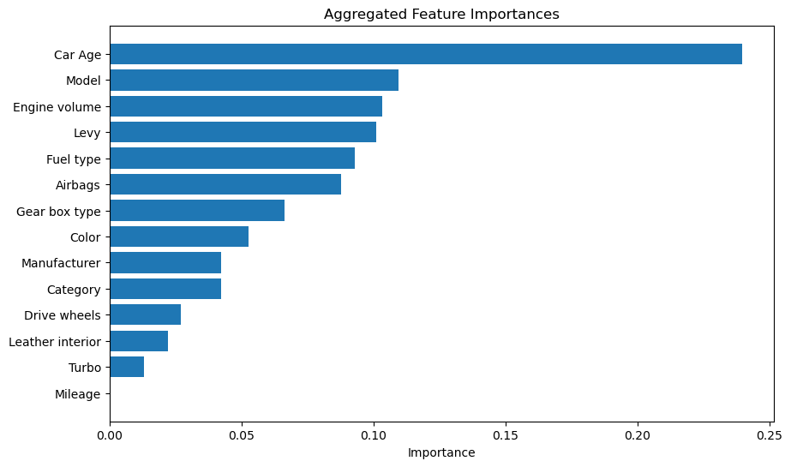
Model Results
Random Forest

Slide 16
Model Results
K-NN
RMSE (Root Mean Square Error): 7157.238
MAE (Mean Absolute Error): 4439.682
R2 Score: 0.596
Time: 9.164s

Slide 17
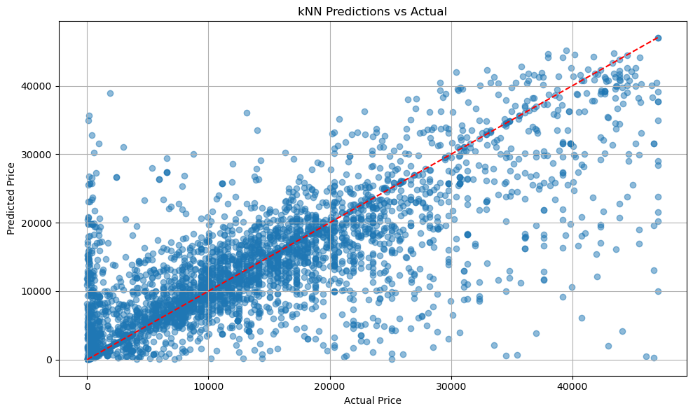
Model Results
Random Forest

Slide 18
Comparison

Slide 19
Comparison

Slide 20
Conclusion
K-NN
Most balanced: k-NN
Most accurate: Random Forest

Slide 21

Thank you!
vasileios.vitzilaios@gmail.com

